Slide 1
Creating a VPC

Slide 2
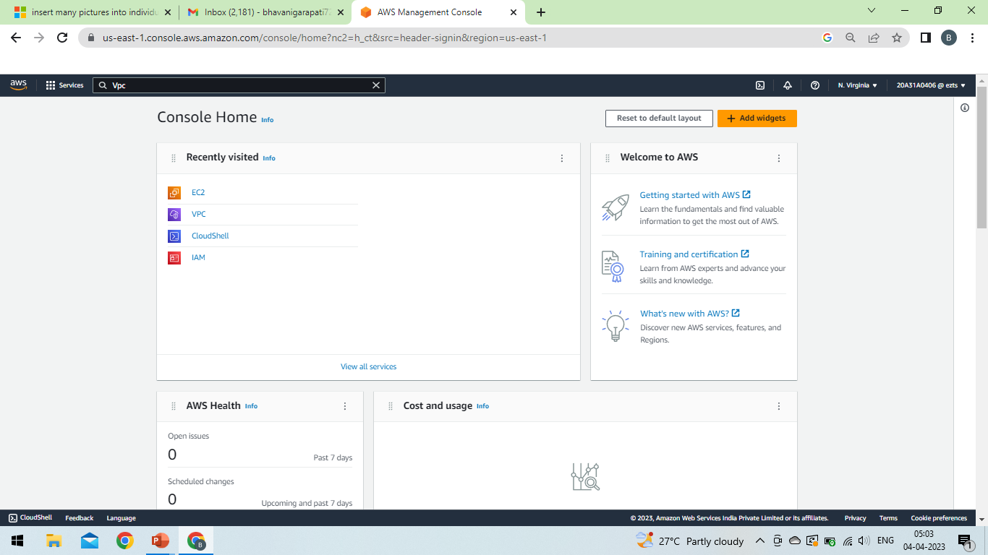
Step-1 : At we have to login to the AWS services with username and password after logging in, console looks like this

Slide 3
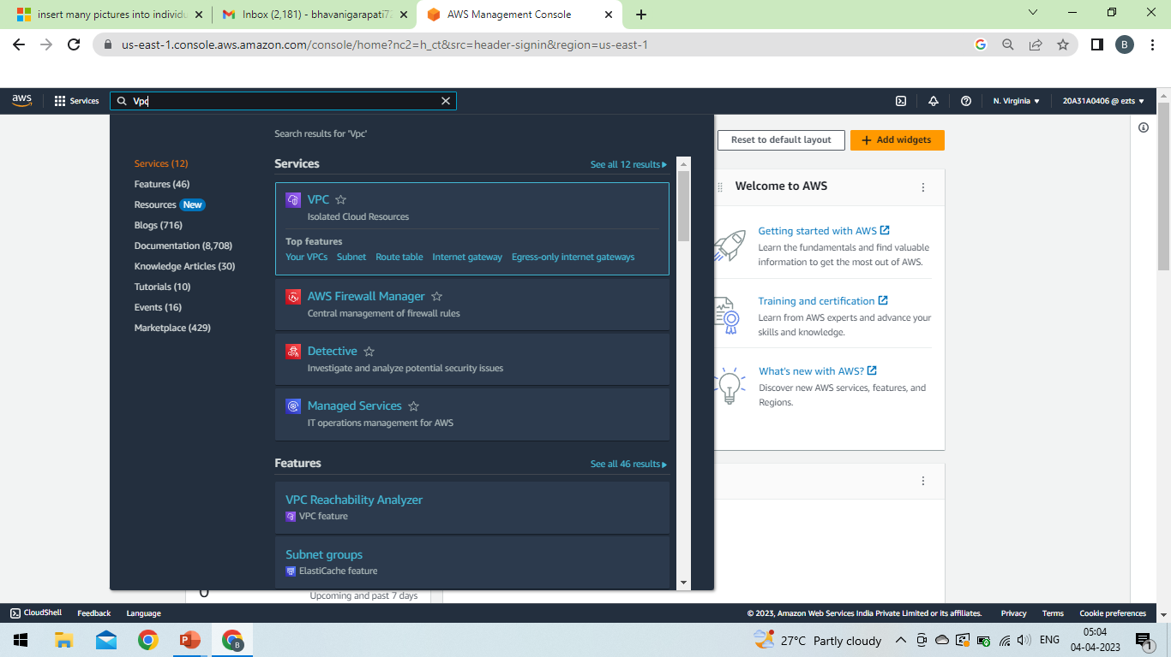
Step-2 : After logging in, click on services and search for VPC and select

Slide 4
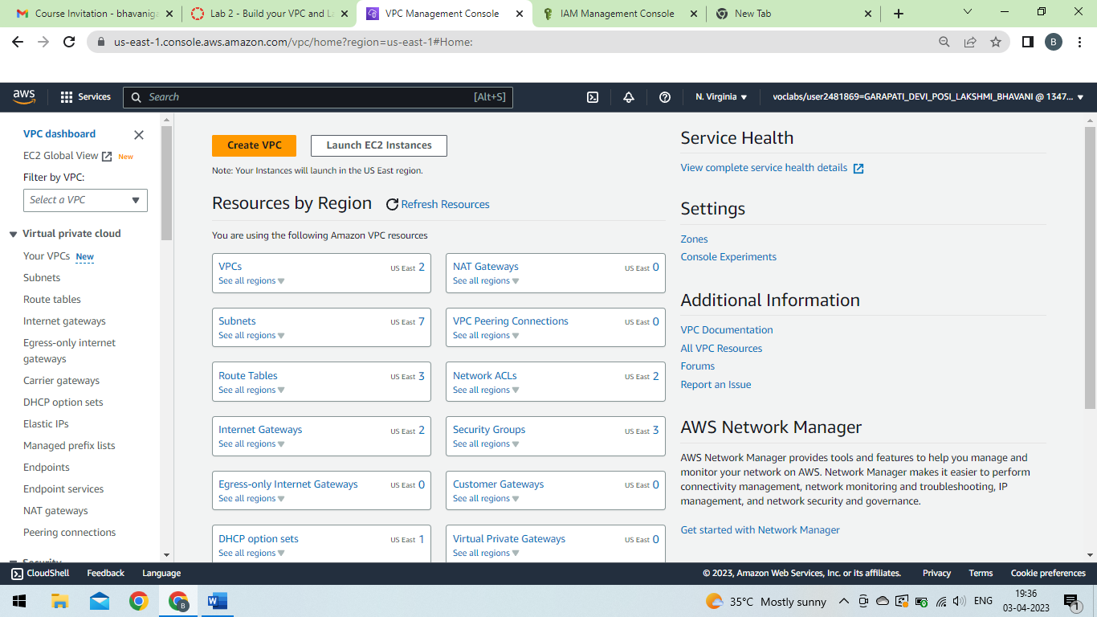
Step – 3 : After clicking on VPC, VPC dashboard appears and choose Create VPC

Slide 5
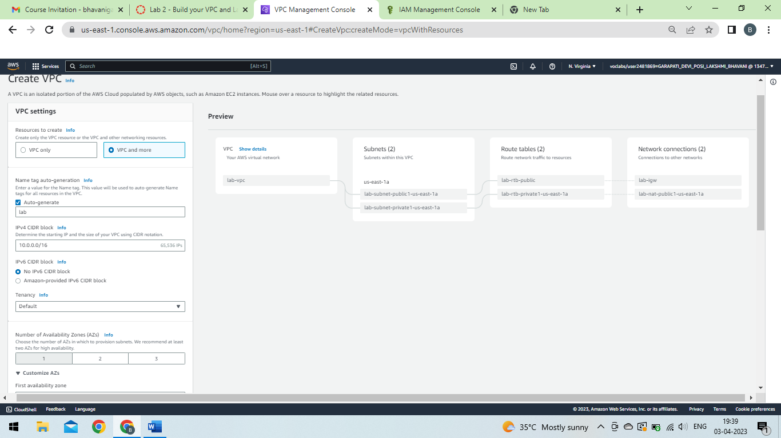
Step – 4 : In VPC settings select VPC and more and also change auto generate to lab

Slide 6
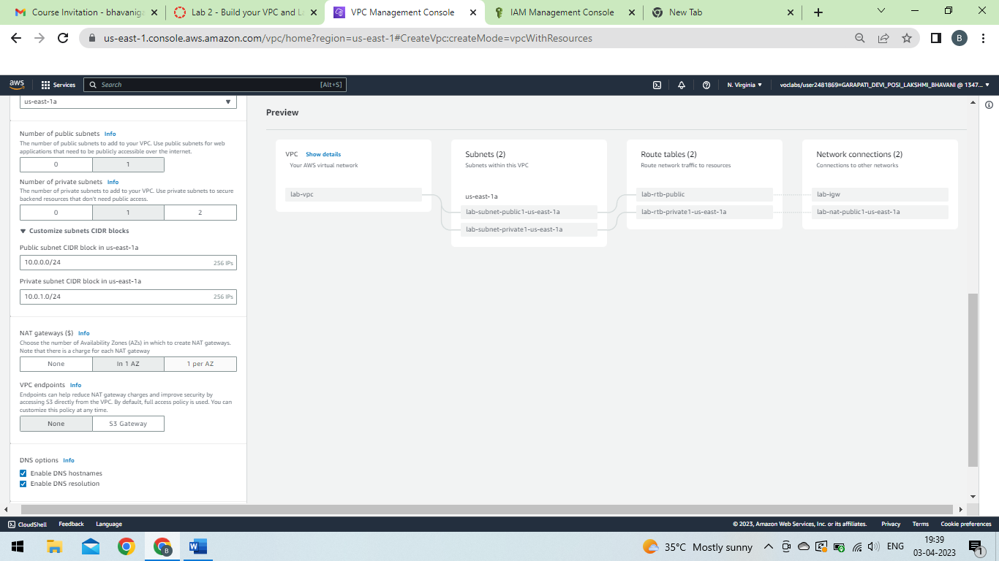

Slide 7
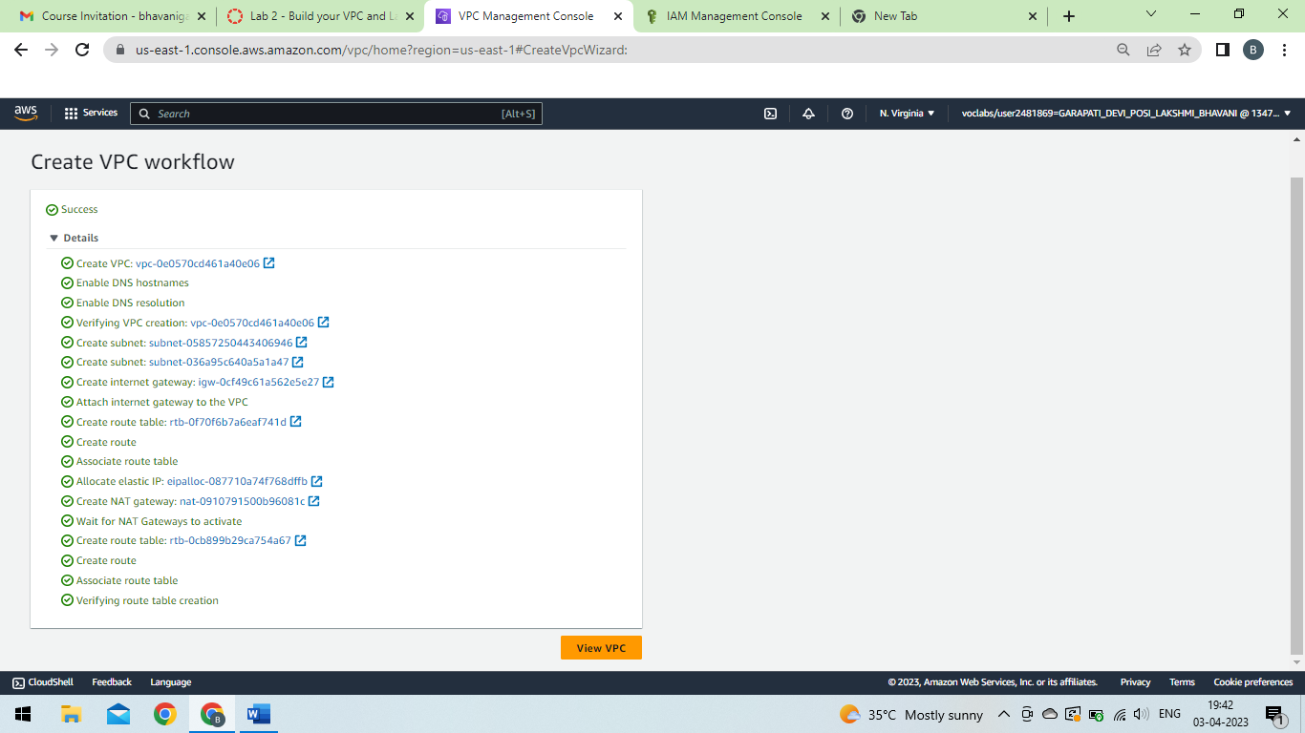

Slide 8
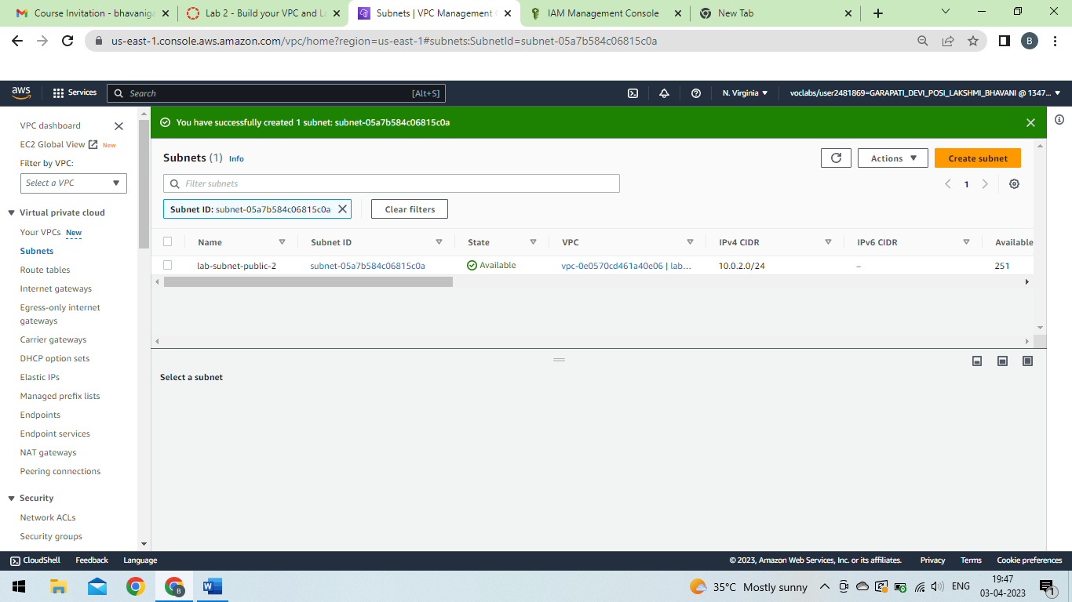

Slide 9
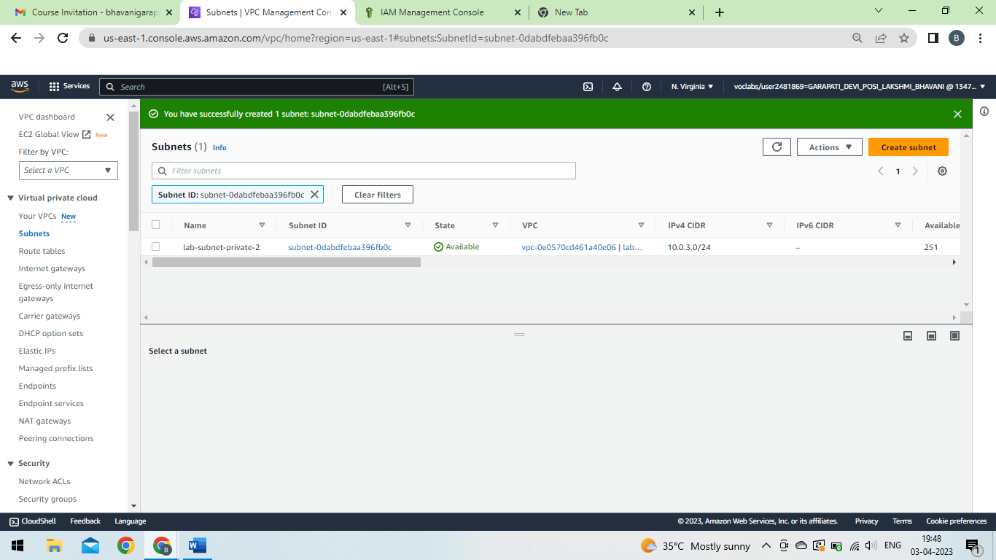

Slide 10
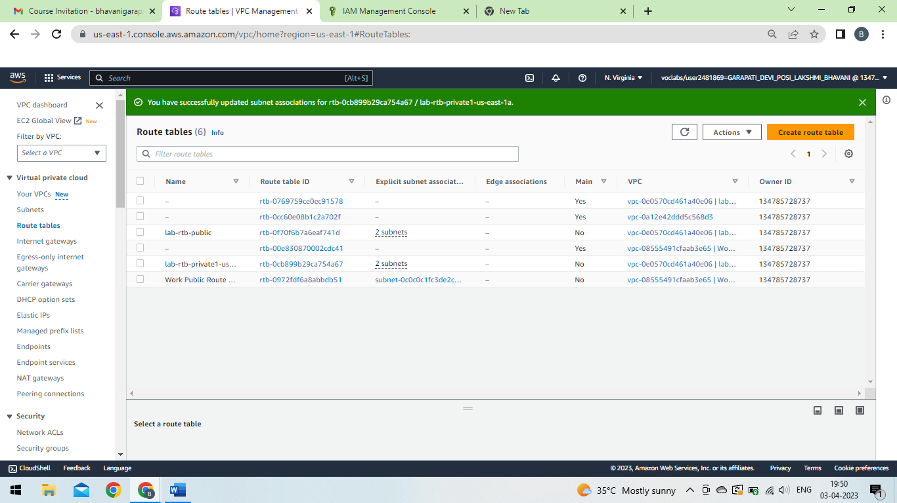

Slide 11
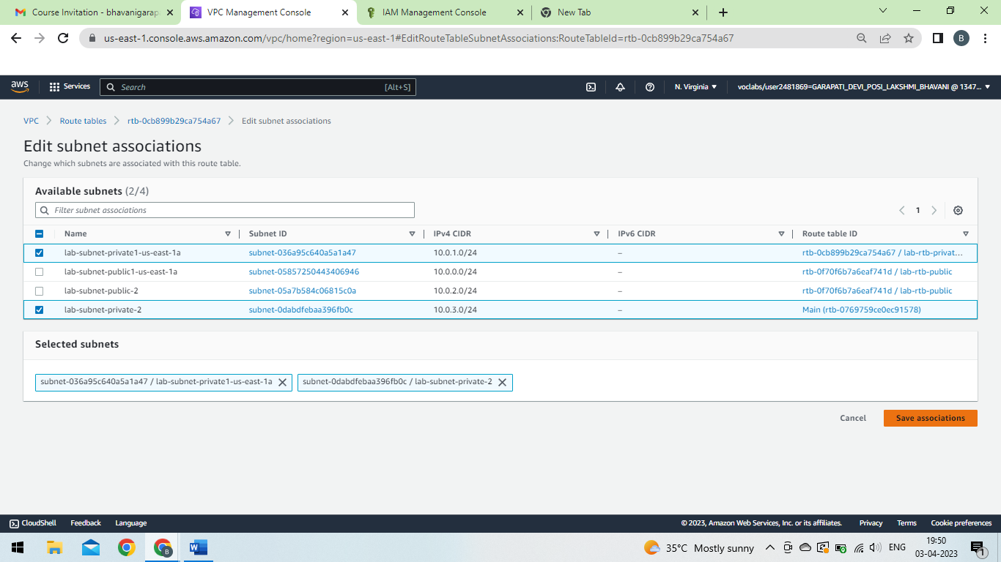

Slide 12
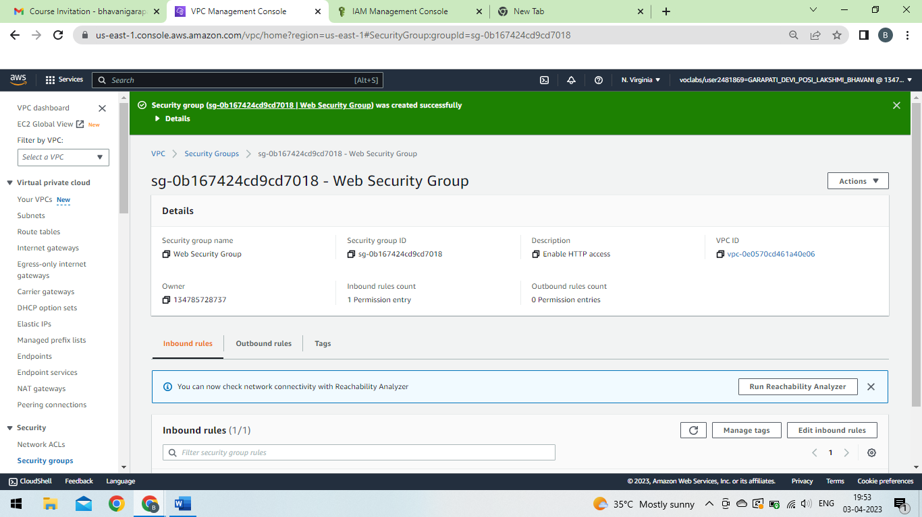

Slide 13
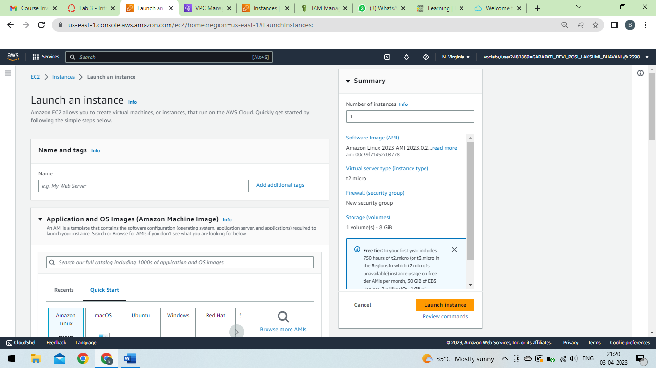

Slide 14
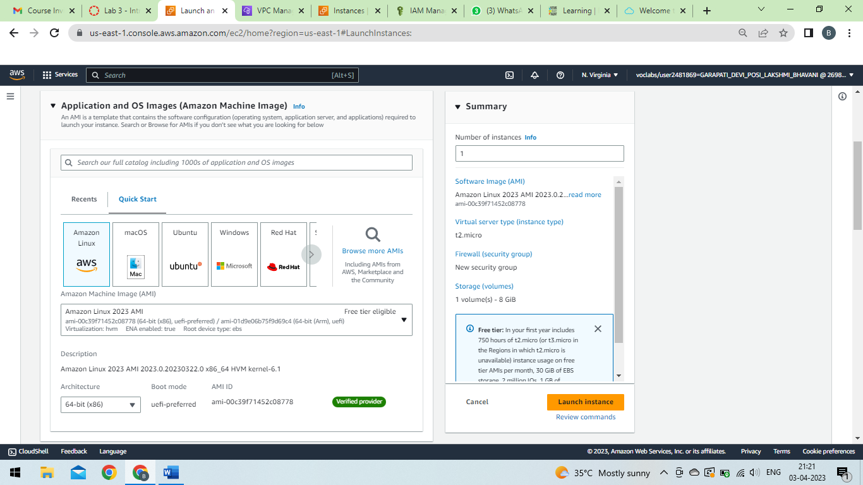

Slide 15
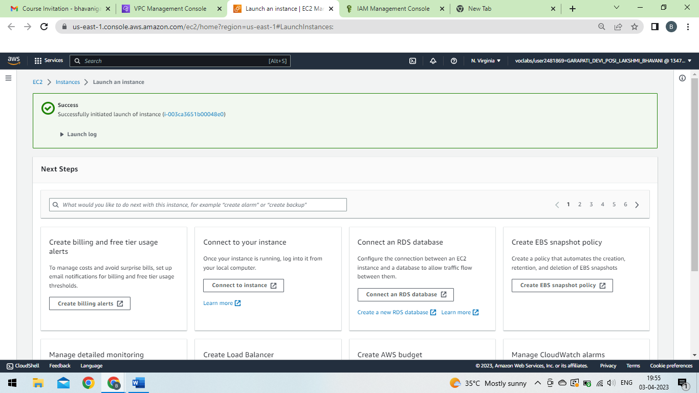

Slide 16
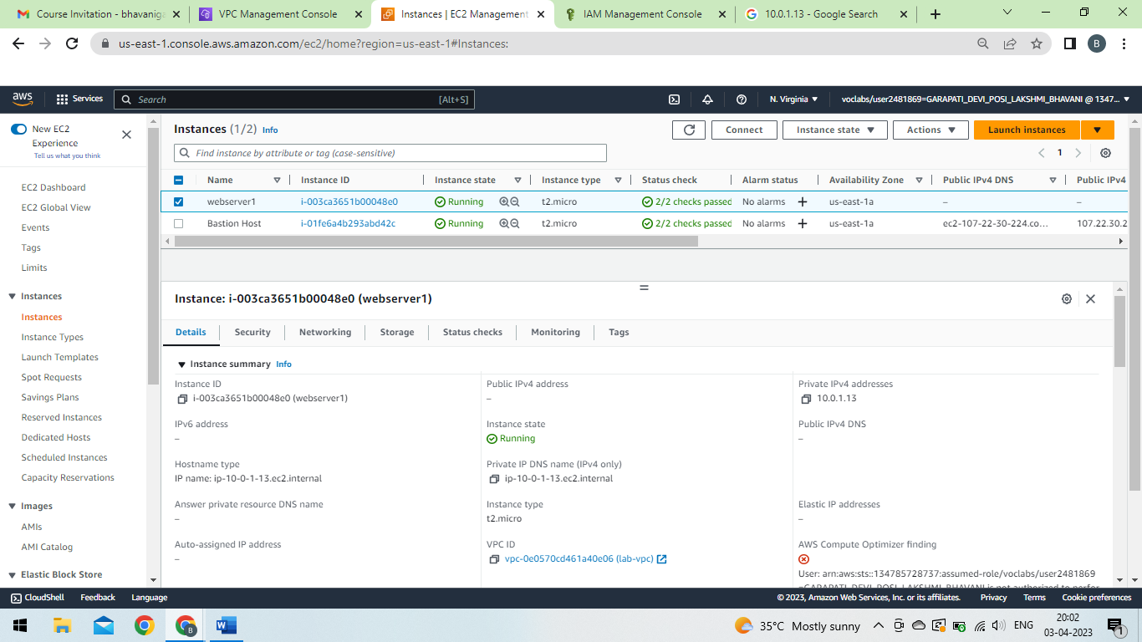

Slide 17
Creating an EC2 Instance

Slide 18
Step-1:In the AWS Management Console choose Services, choose Compute and then choose EC2.
Step-2:Choose the Launch instance menu and select Launch instance.
Step-3:Give the instance the name as you prefer.
Step-4:Choose AMI as your preference.
Step-5:In the Instance type panel, keep the default t2.micro selected.
Step-6:For Key pair name - required, create keypair.
Step-7:Next to Network settings .
Step-8:choose create Instance.

Slide 21
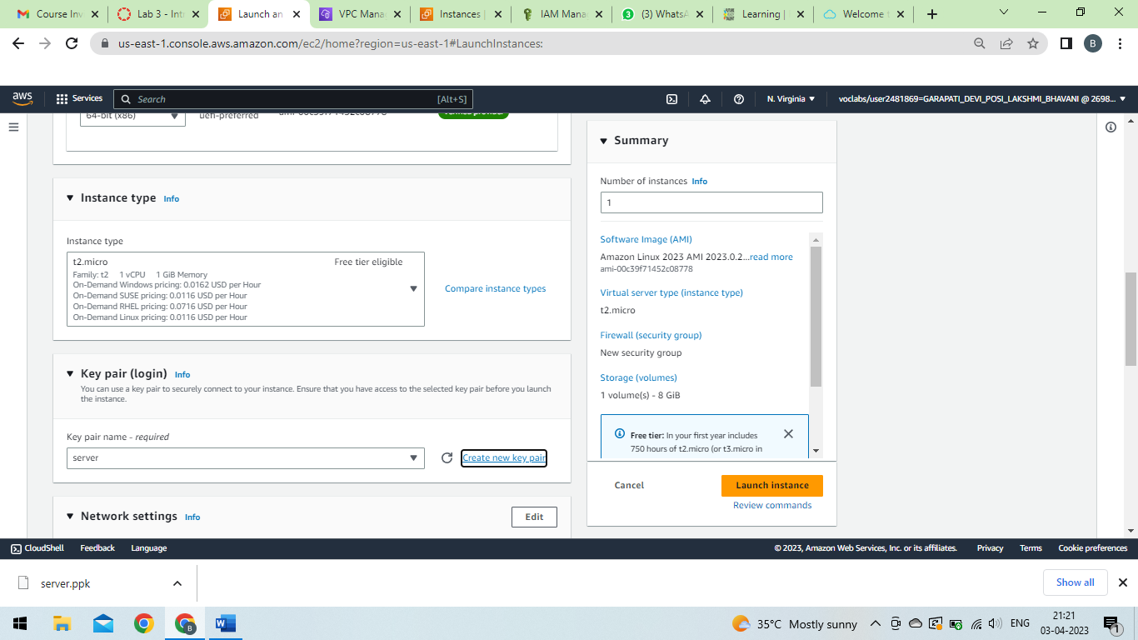

Slide 22
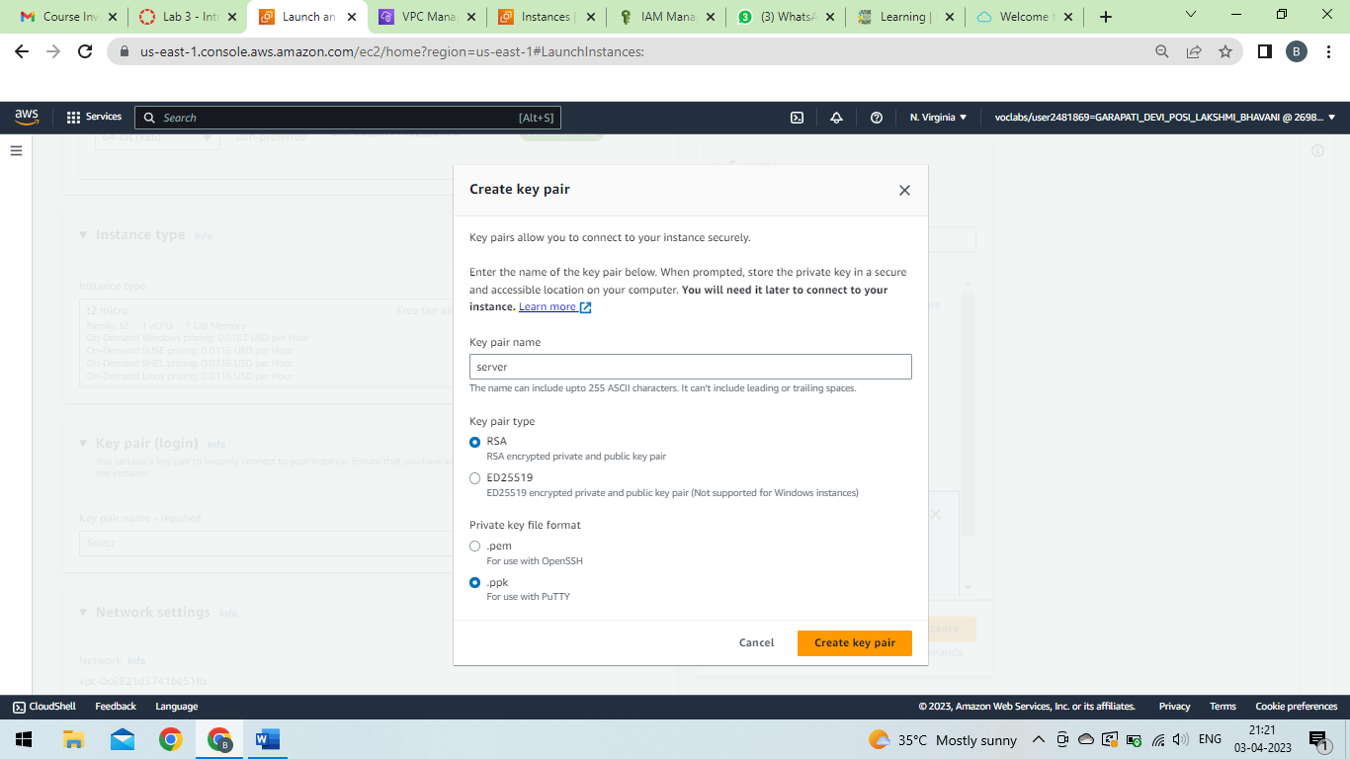

Slide 23
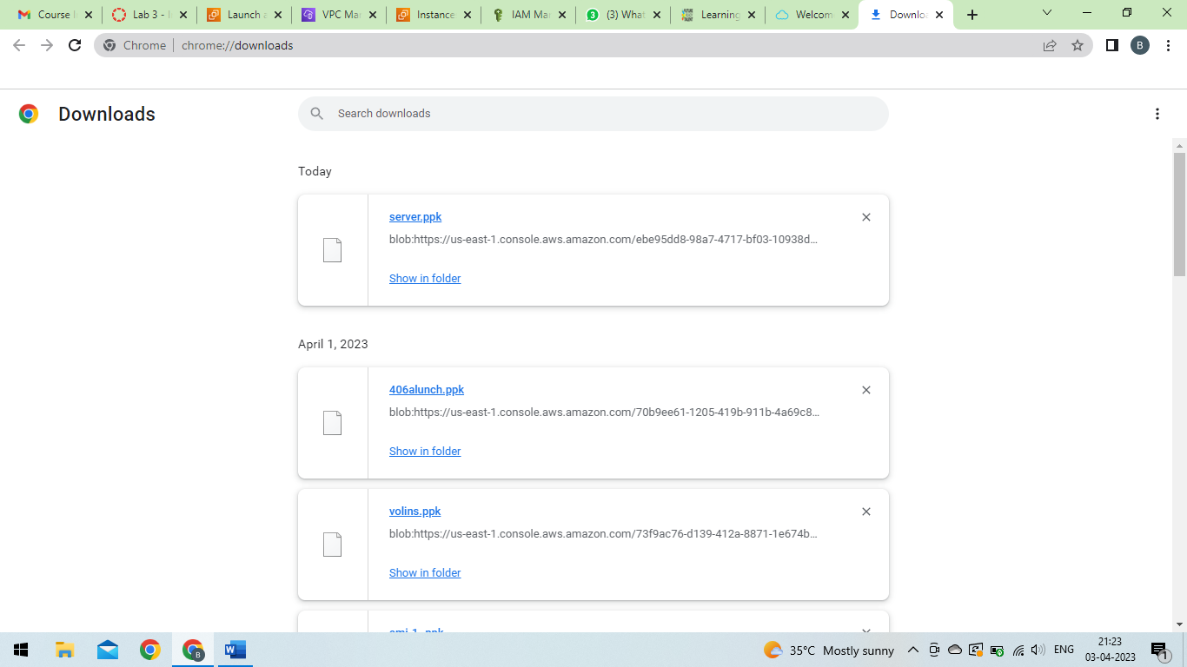

Slide 24
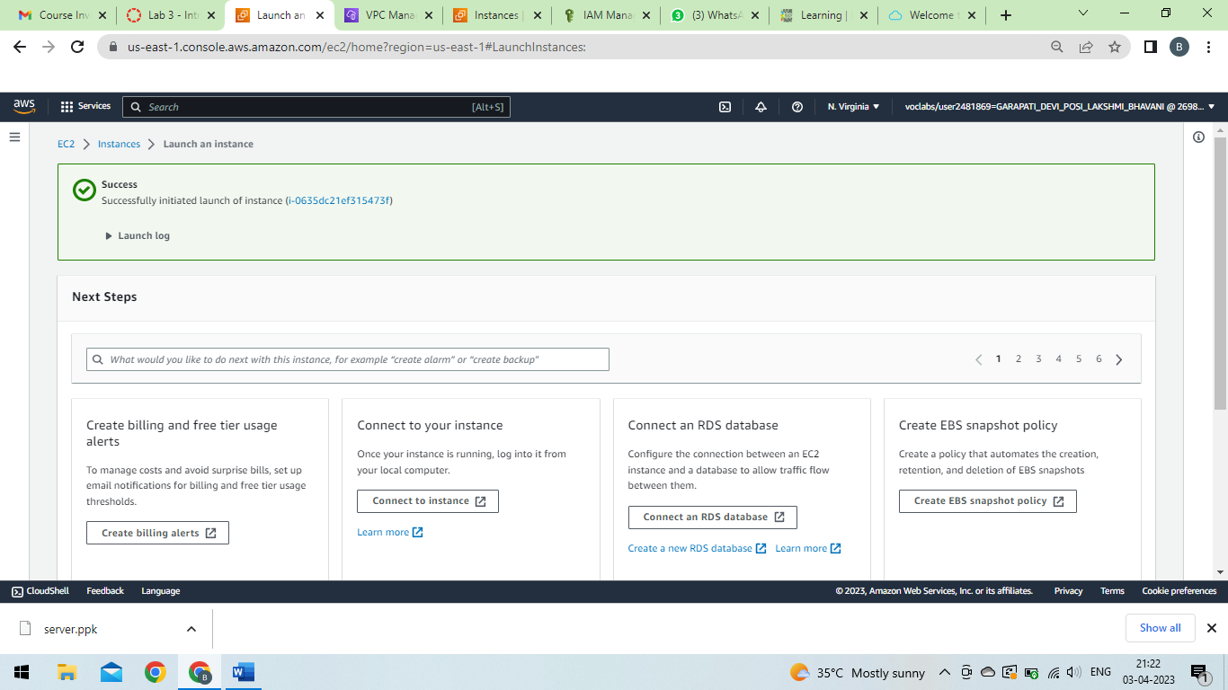

Slide 25
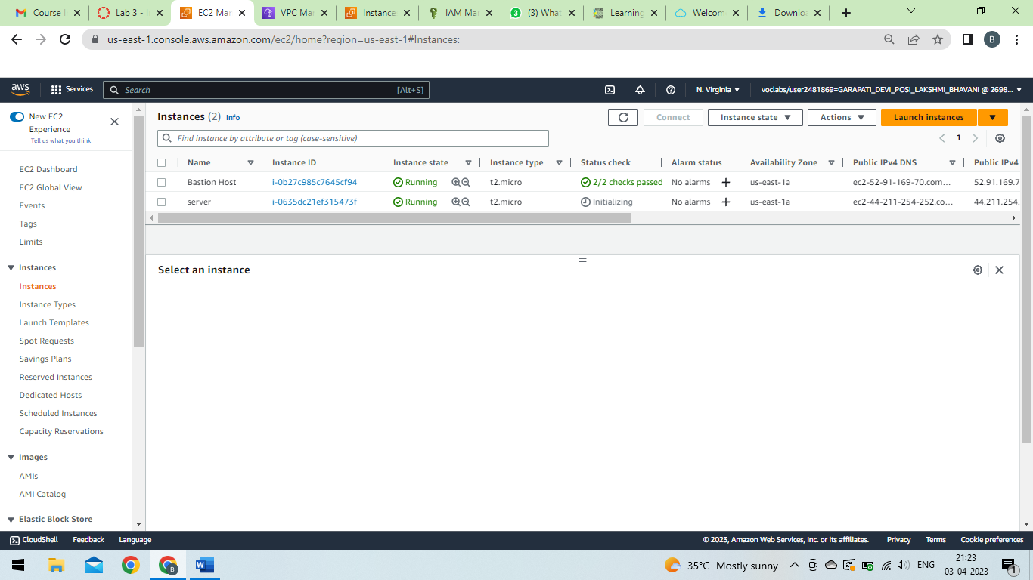

Slide 26
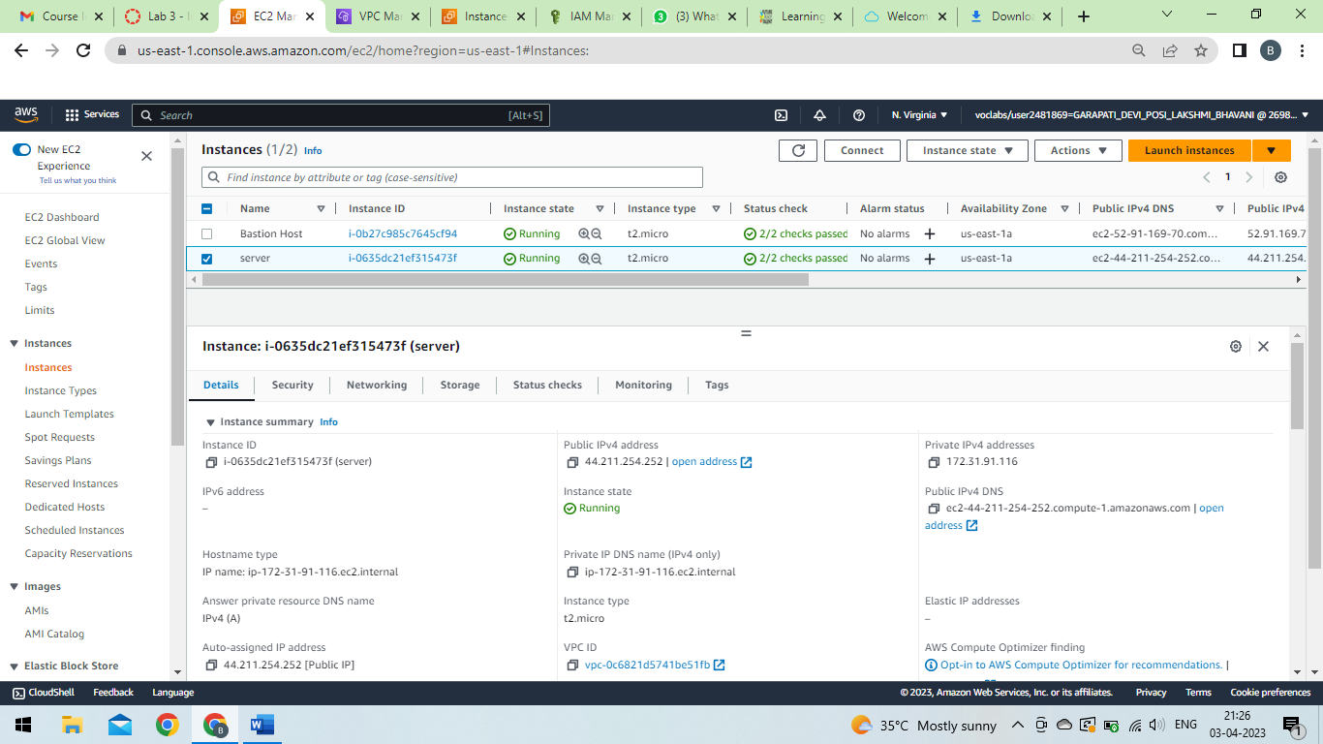

Slide 27
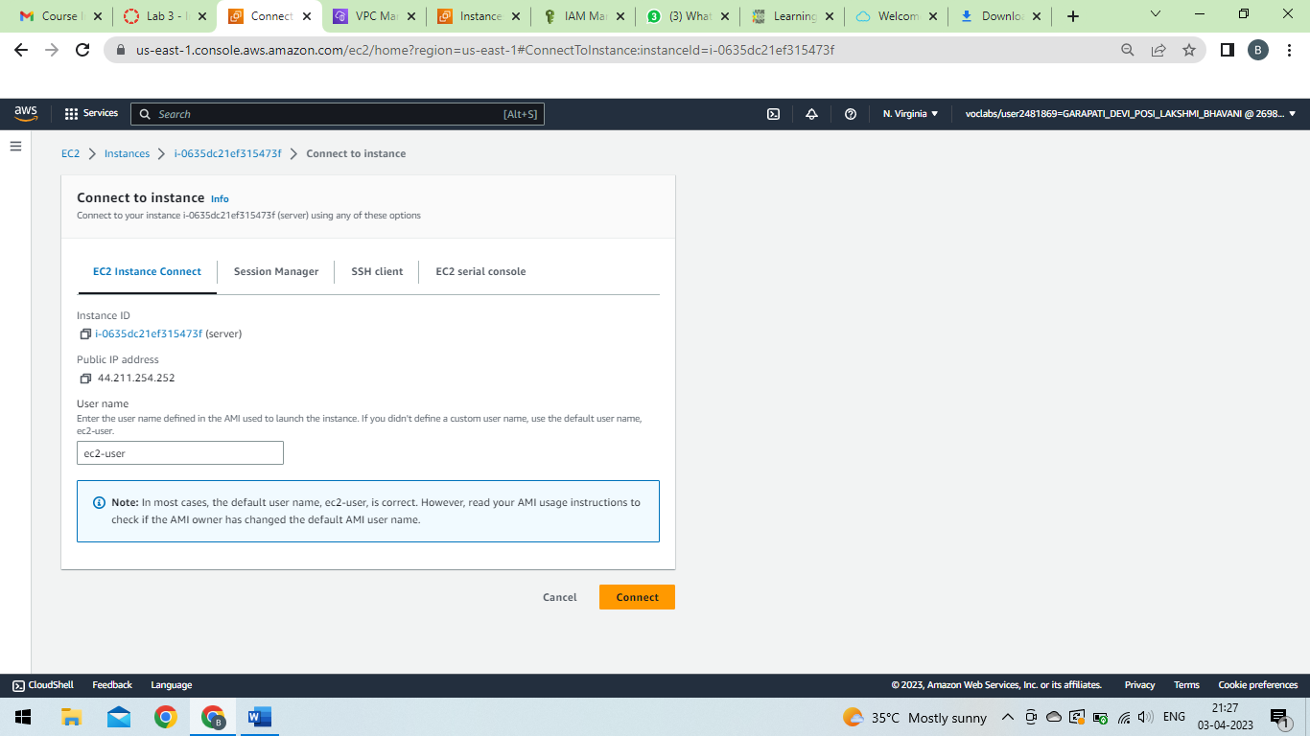

Slide 28
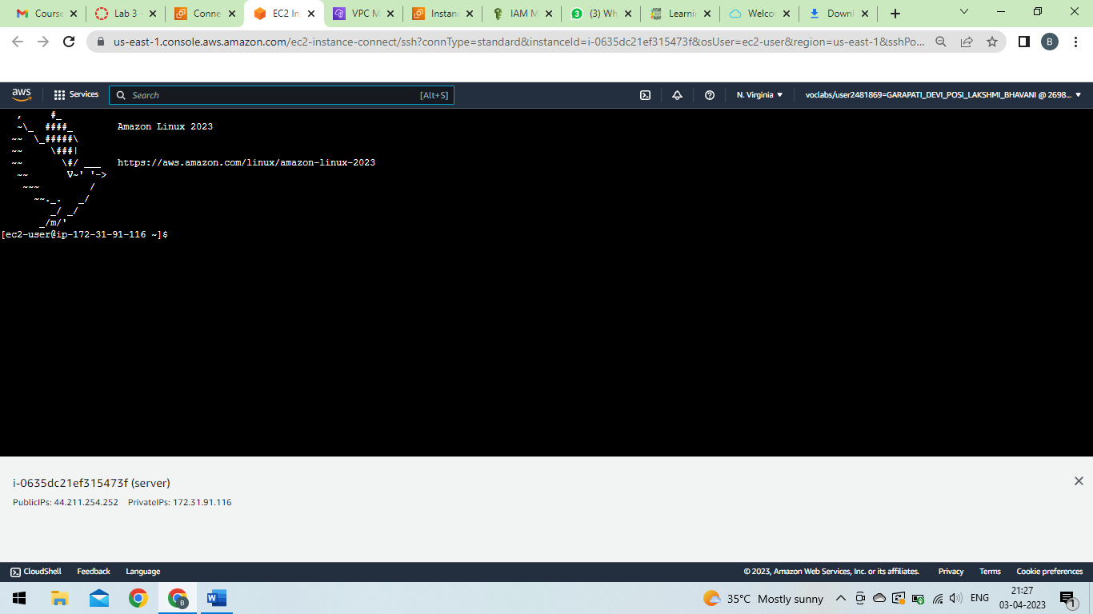

Slide 29
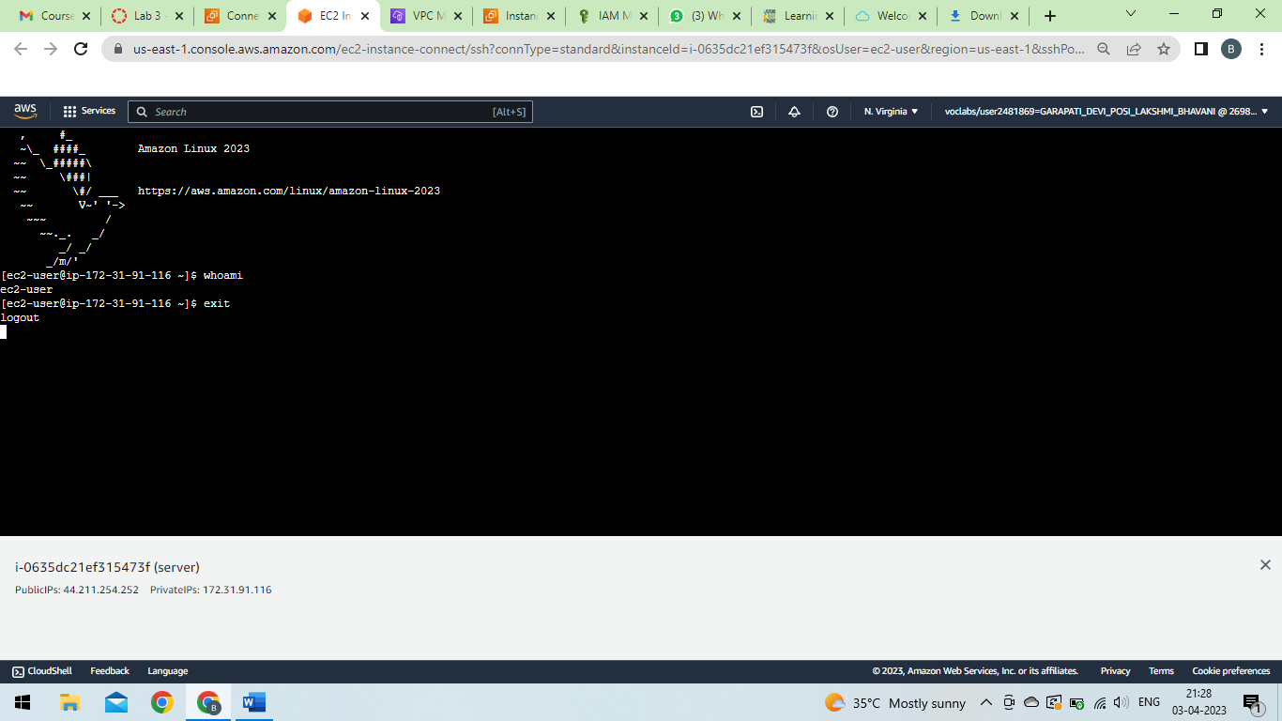

Slide 30
RDS

Slide 31
Step1: In the AWS Management Console, on the Services menu, choose VPC.
Step2: In the left navigation pane, choose Security Groups.
Step3: Choose Create security group and then configure:
Security group name: DB Security Group
Description: Permit access from Web Security Group
VPC: Lab VPC
Step4: In the Inbound rules pane, choose Add rule.
Step 5: Configure the following settings:
Type: MySQL/Aurora (3306)
CIDR, IP, Security Group or Prefix List: Type sg and then select Web Security Group.
Step 6: Choose Create security group.

Slide 32
Step 7: In the left navigation pane, choose Subnet groups.
If the navigation pane is not visible, choose the menu icon in the top-left corner.
Step 8: Choose Create DB Subnet Group then configure:
Step 9: Scroll down to the Add Subnets section.
Step 10: Expand the list of values under Availability Zones and select the first two zones: us-east-1a and us-east-1b.
Step 11: Expand the list of values under Subnets and select the subnets associated with the CIDR ranges 10.0.1.0/24 and 10.0.3.0/24.
These subnets should now be shown in the Subnets selected table.
Step 12: Choose Create and select Database
Step 13 : Choose Create database.
Step 14: Select MySQL.

Slide 33
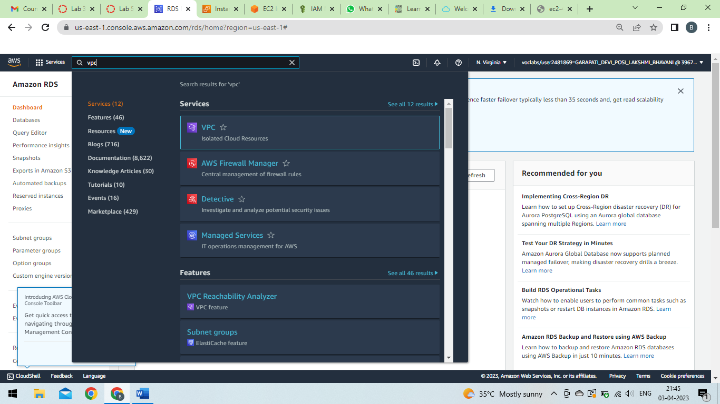

Slide 34
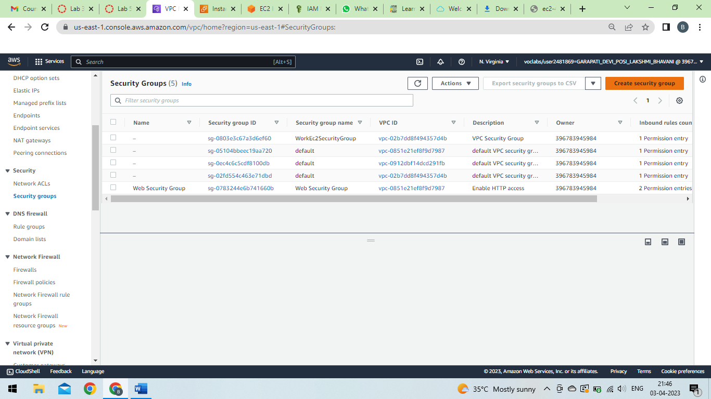

Slide 35
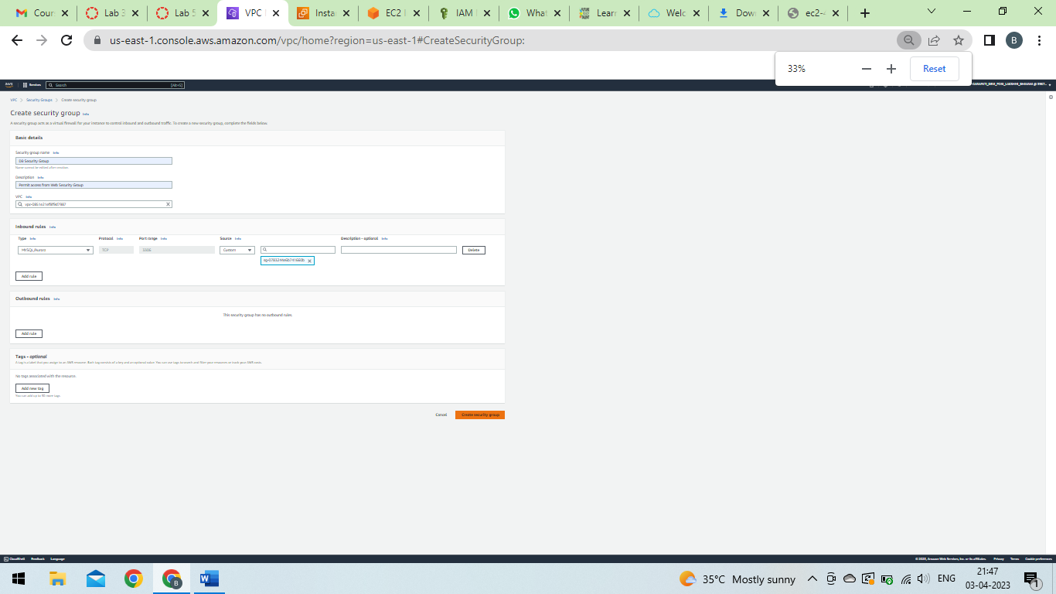

Slide 36
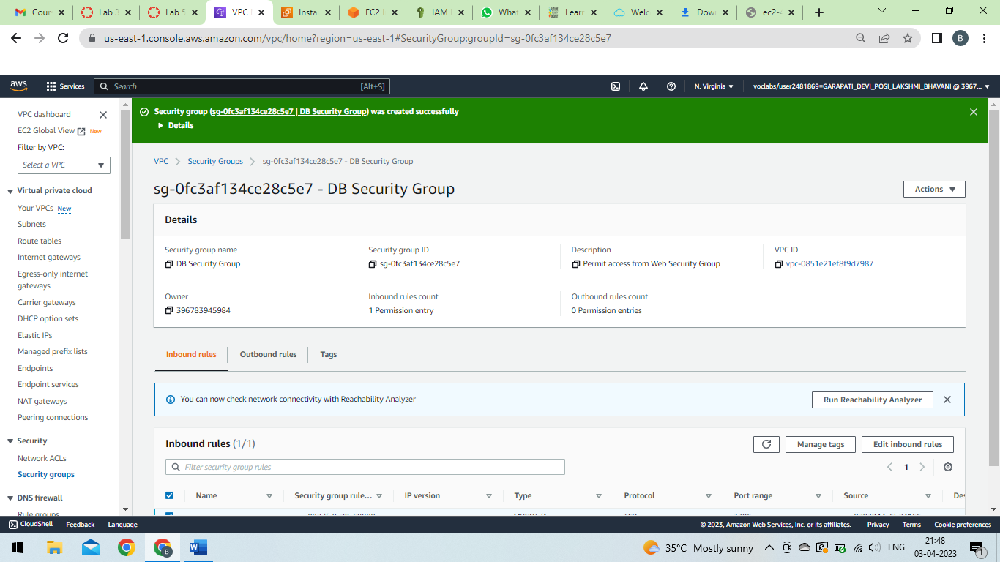

Slide 37
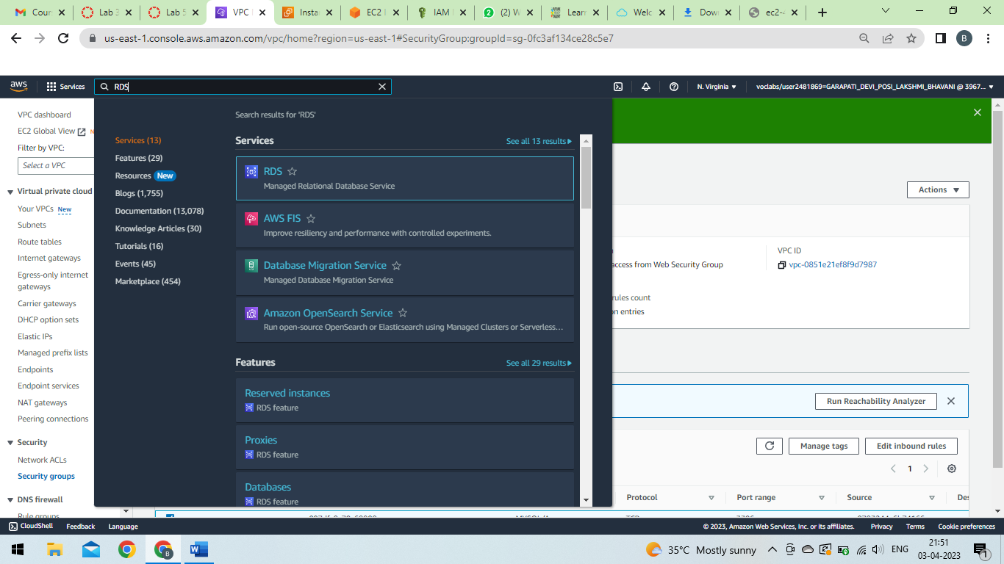

Slide 38
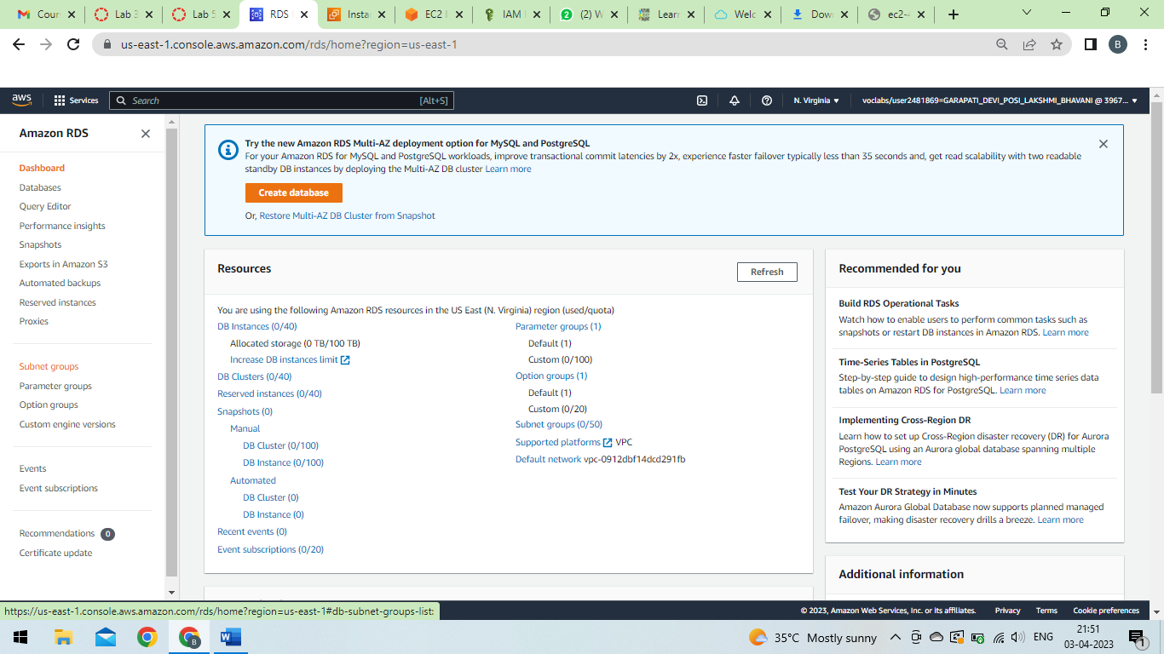

Slide 39
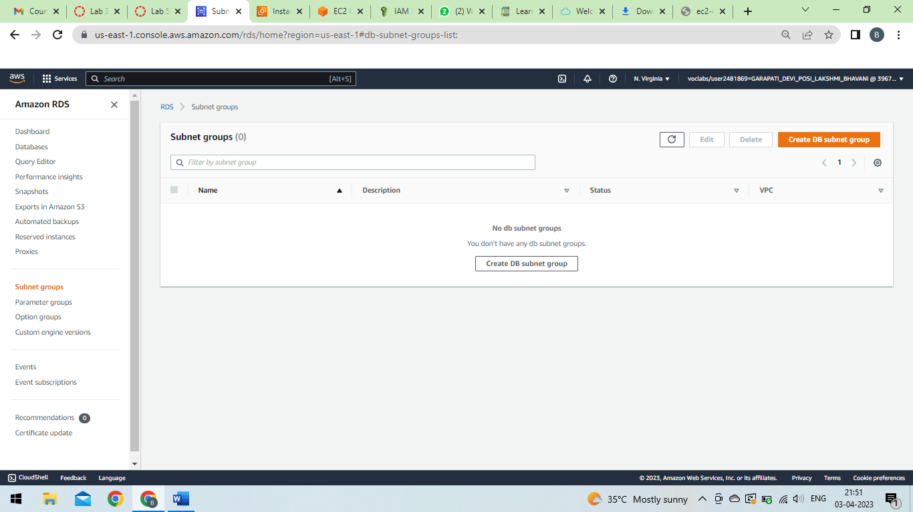

Slide 40
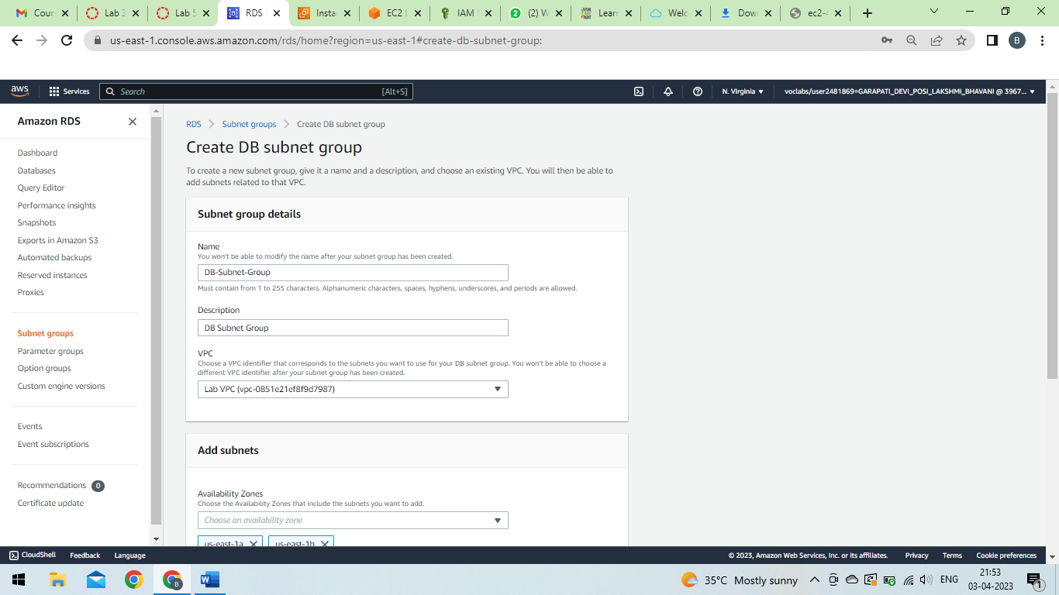

Slide 41
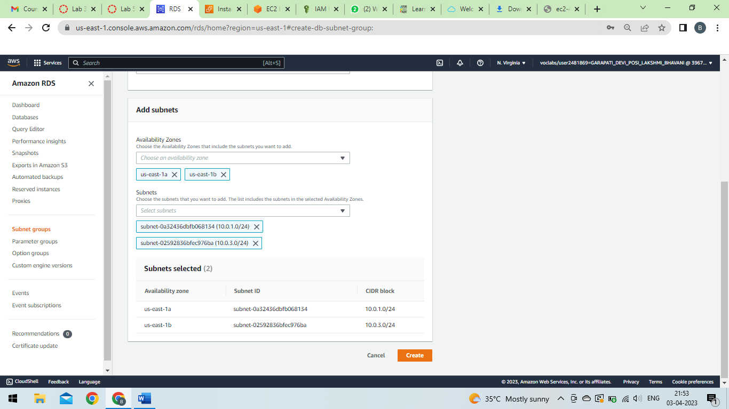

Slide 42
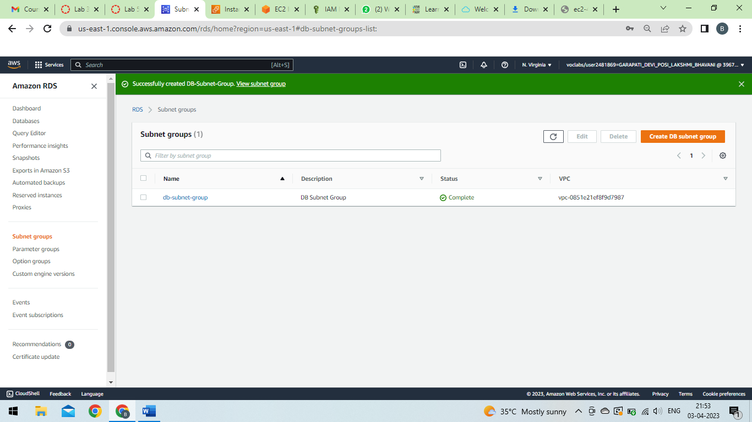

Slide 43
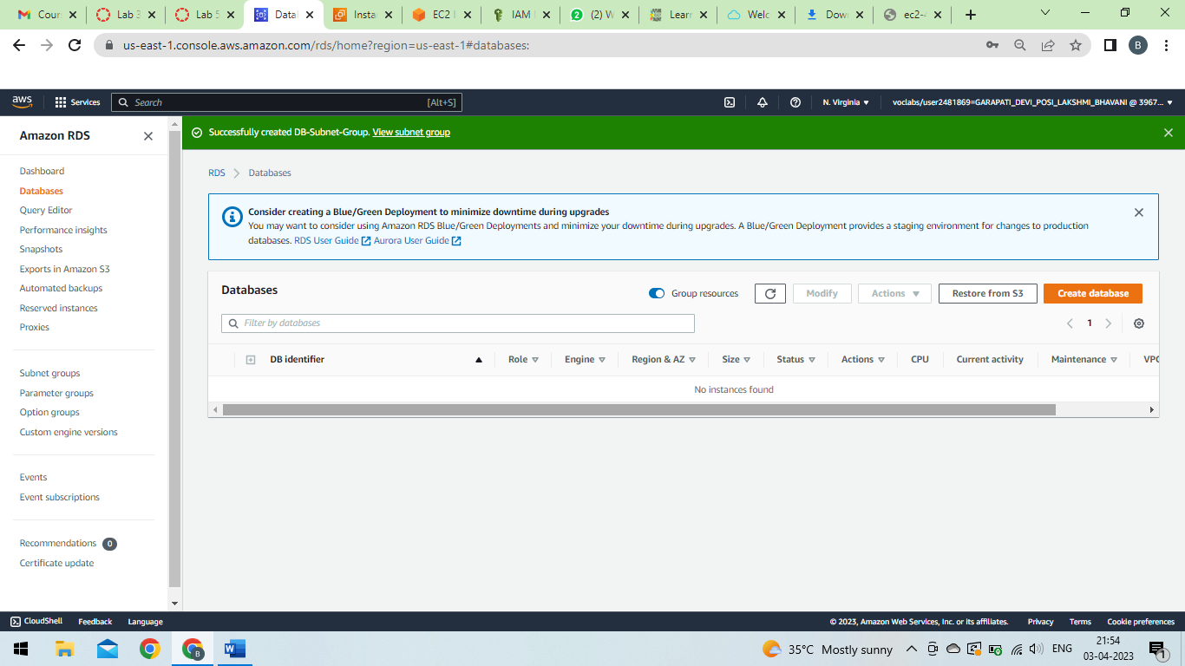

Slide 44
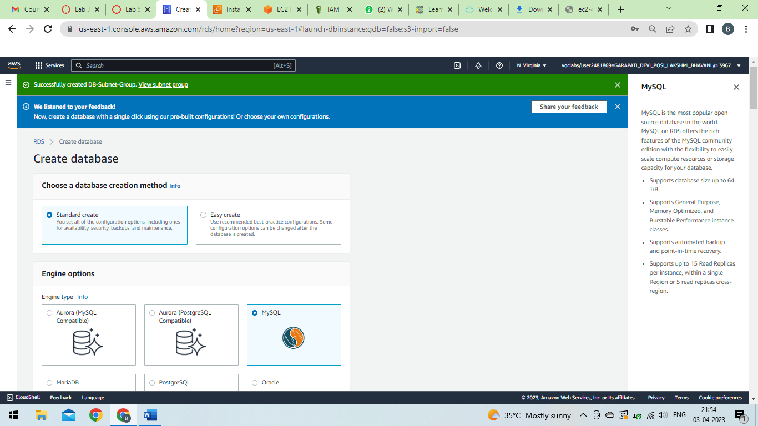

Slide 45
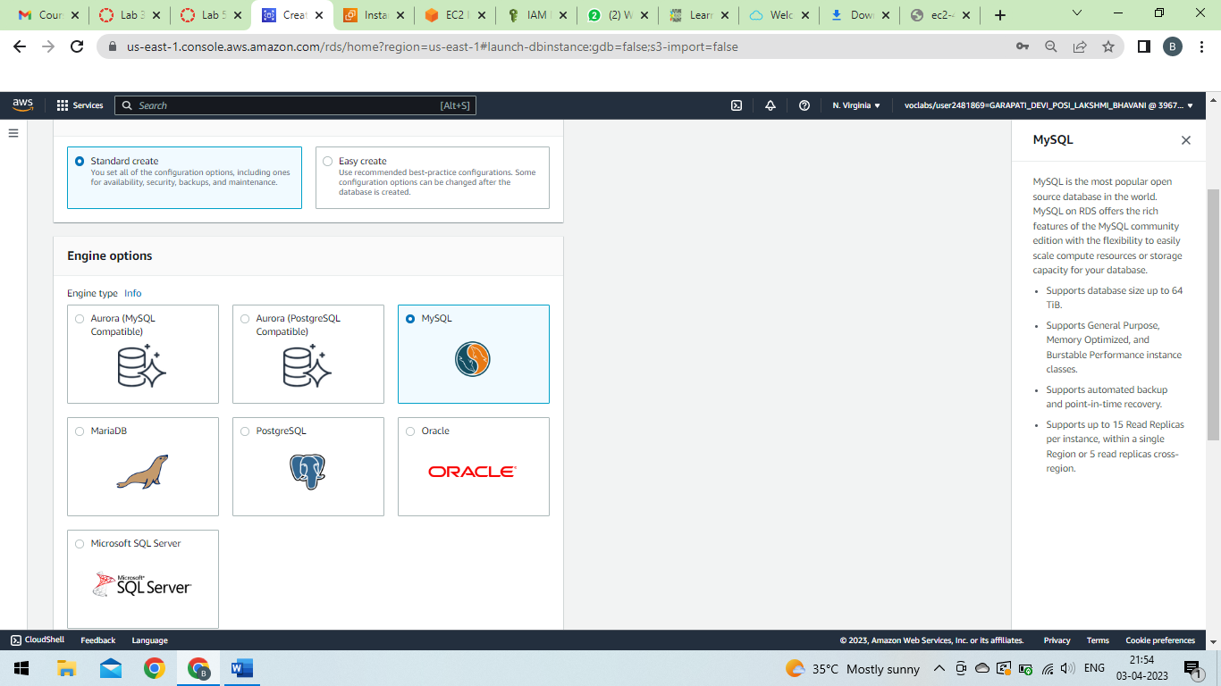

Slide 46
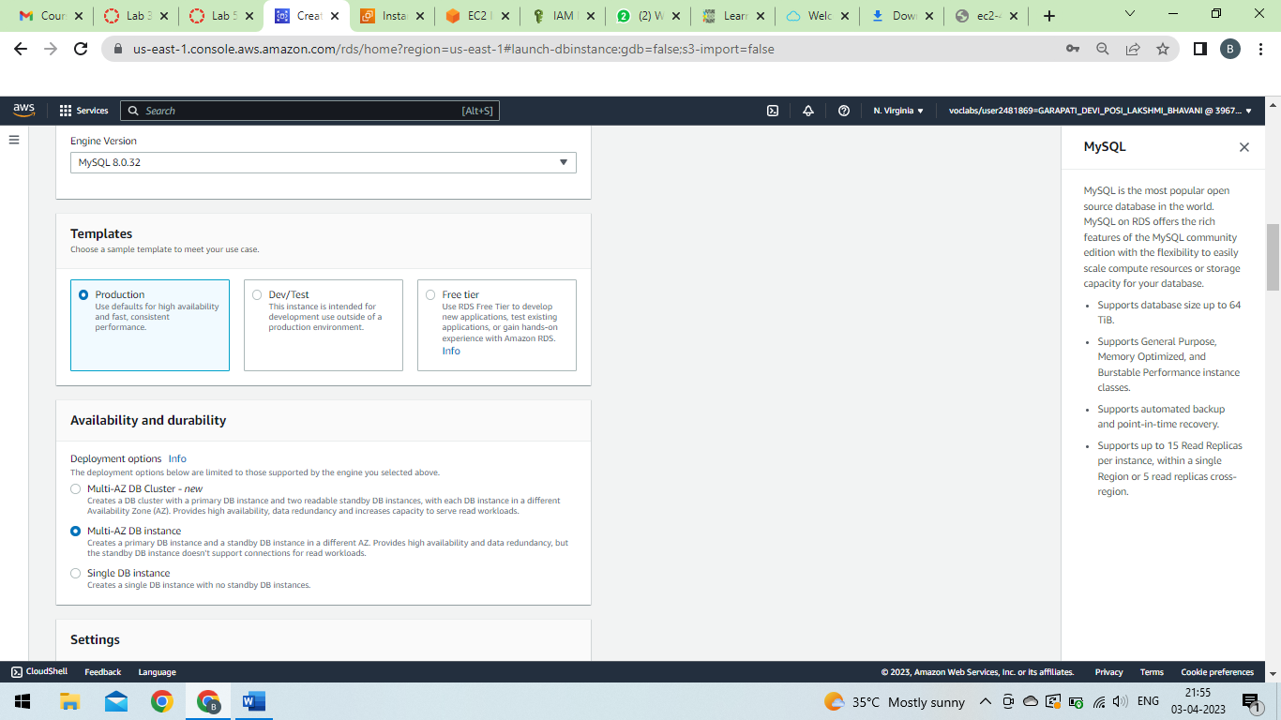

Slide 47
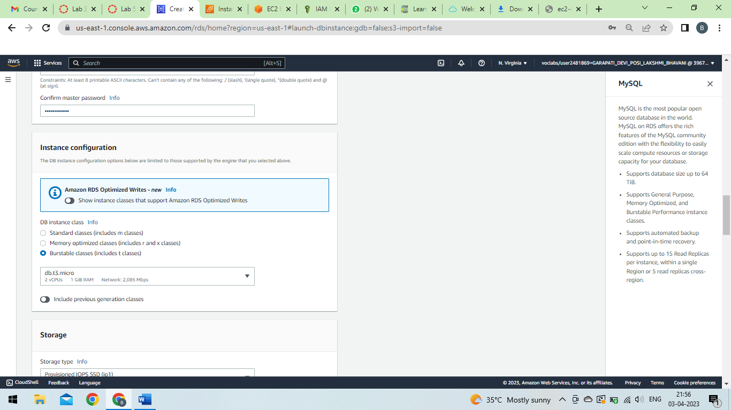

Slide 48
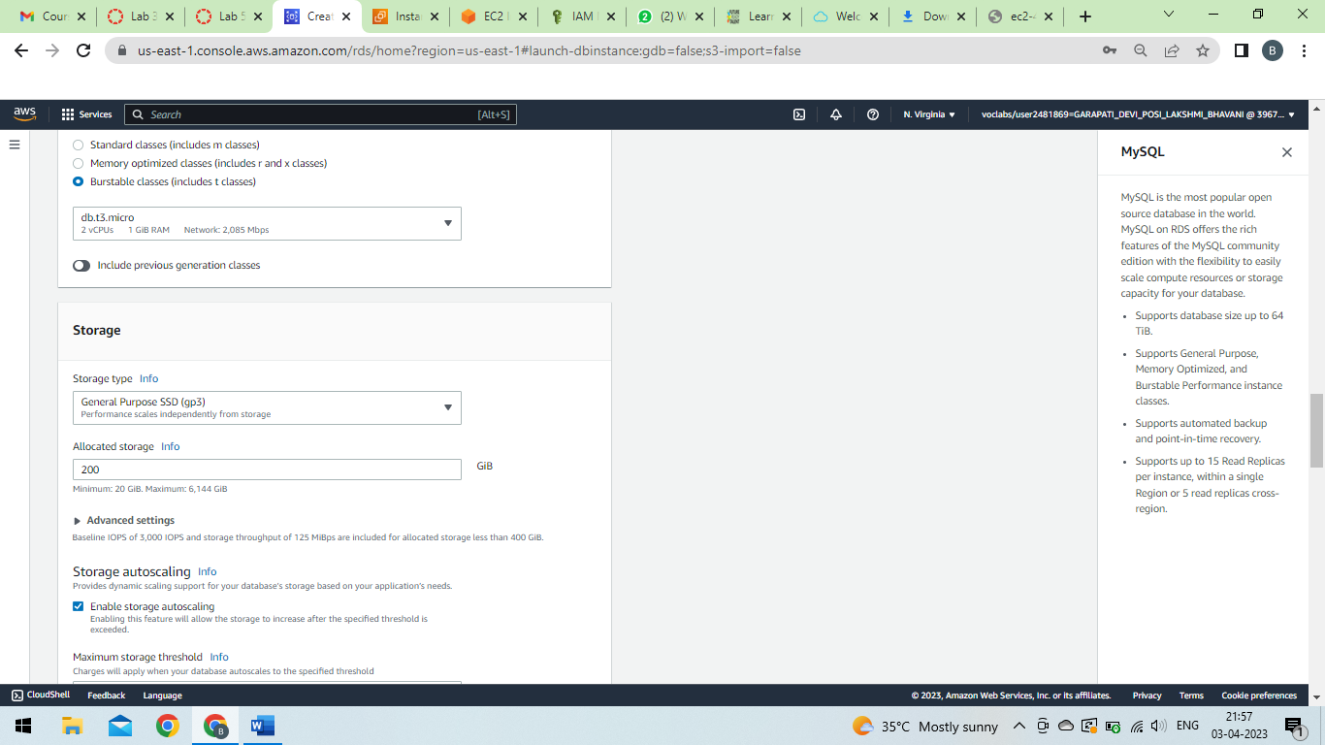

Slide 49
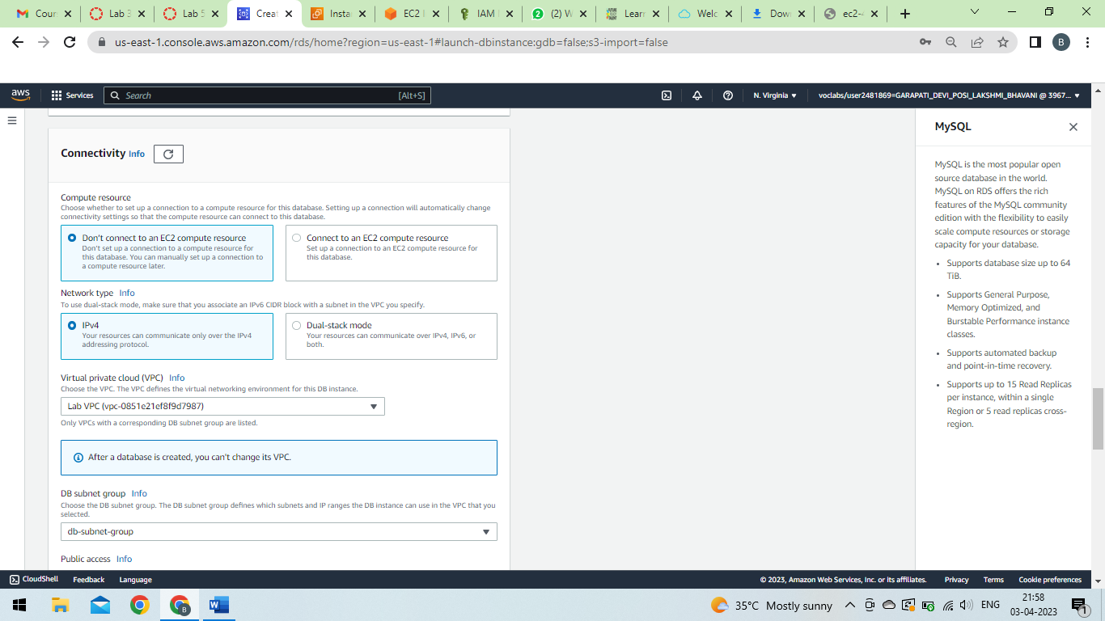

Slide 50
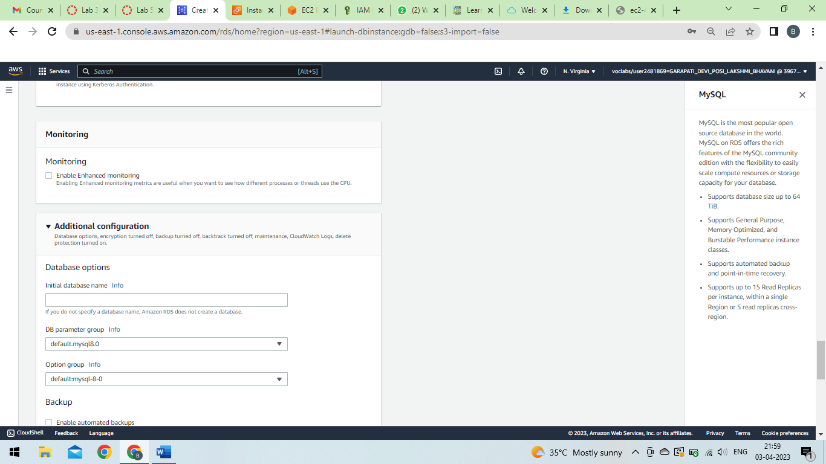

Slide 51
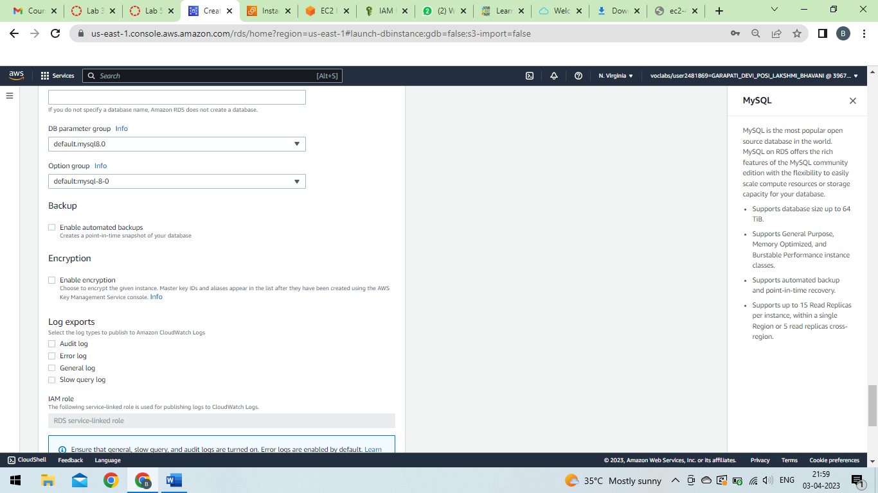

Slide 52
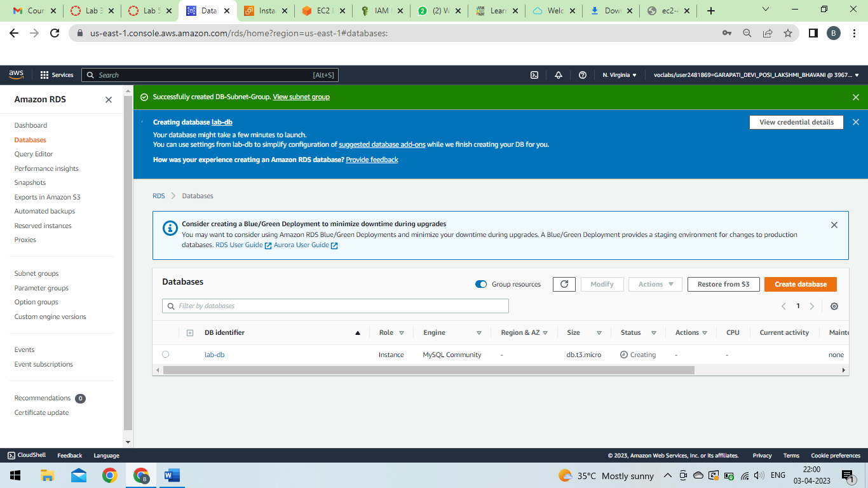

Slide 53
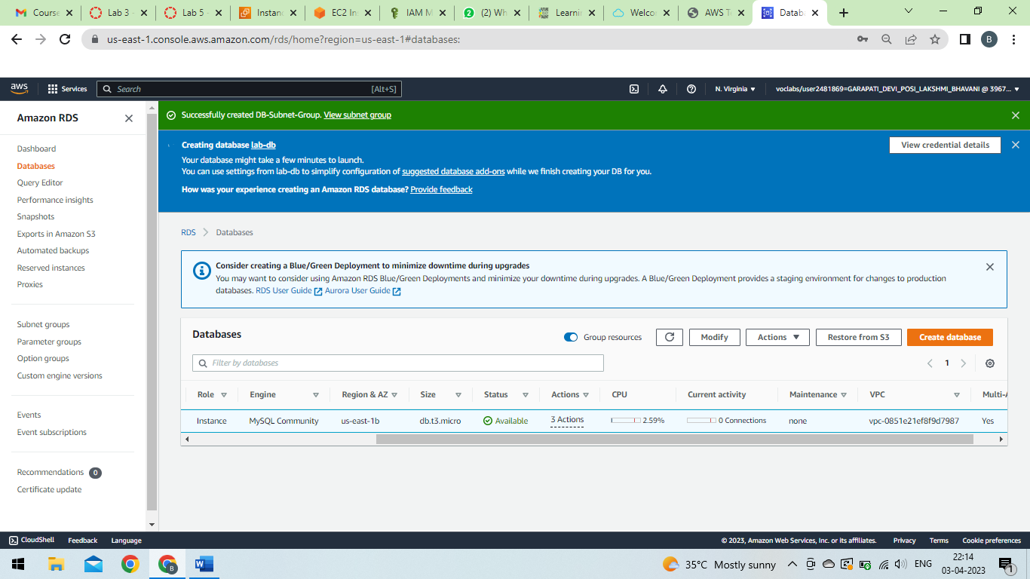

Slide 54
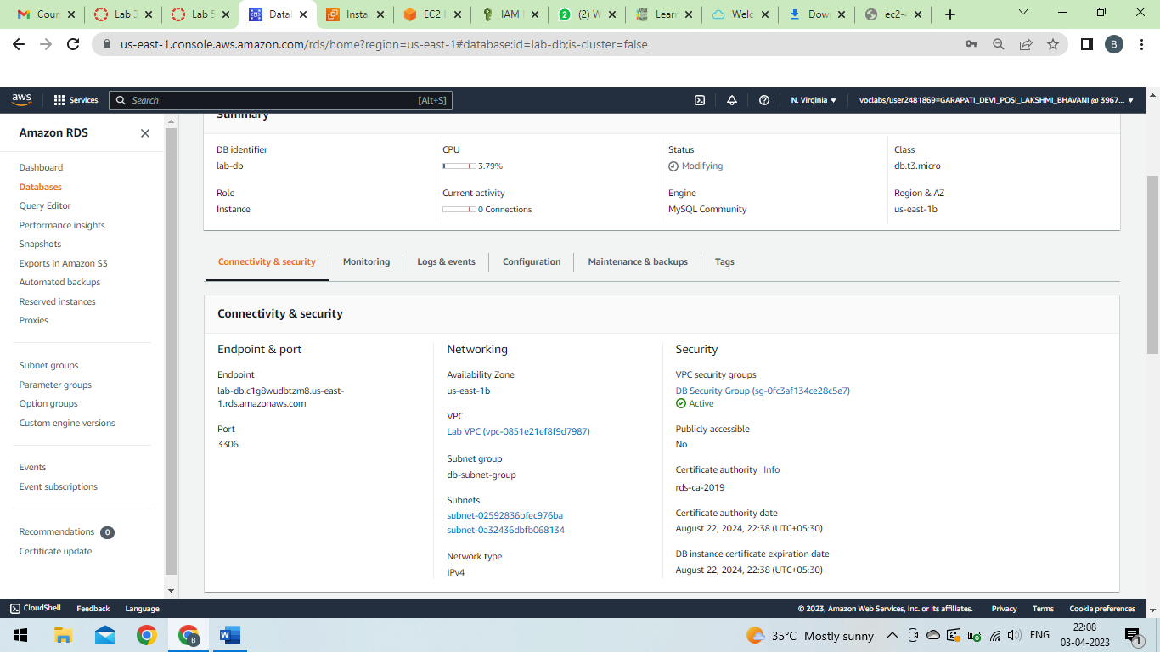

Slide 55
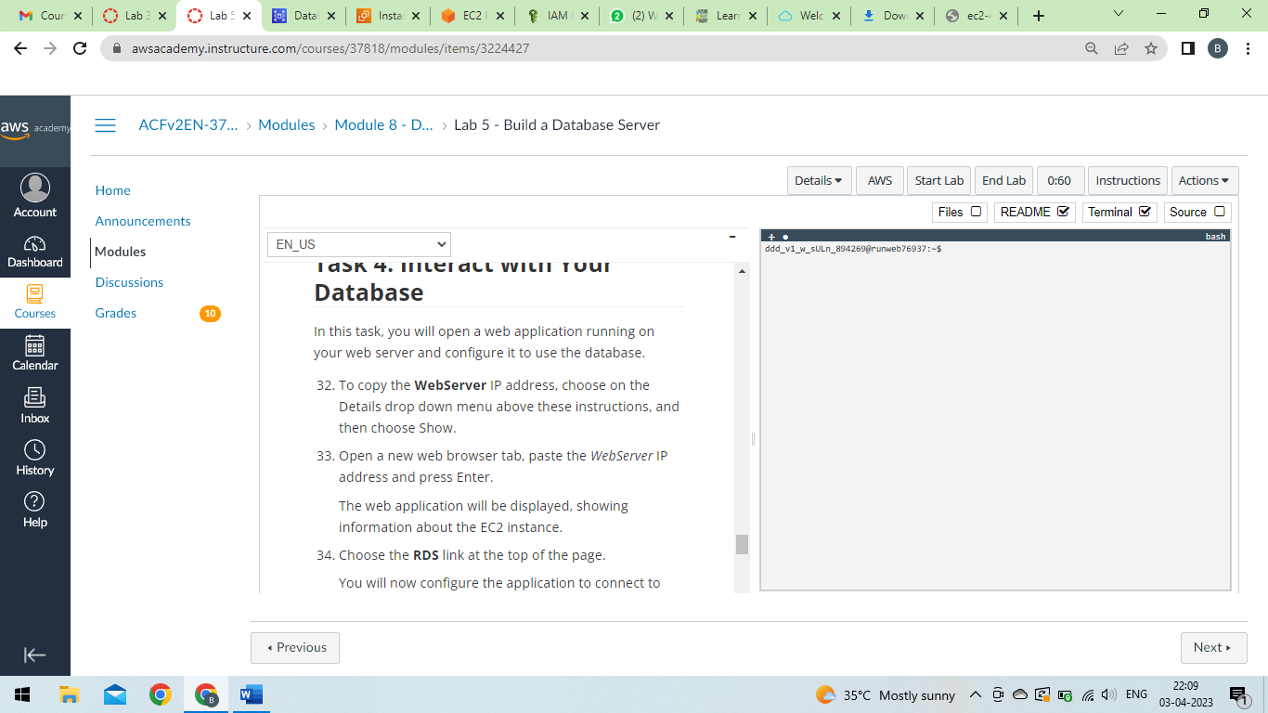

Slide 56
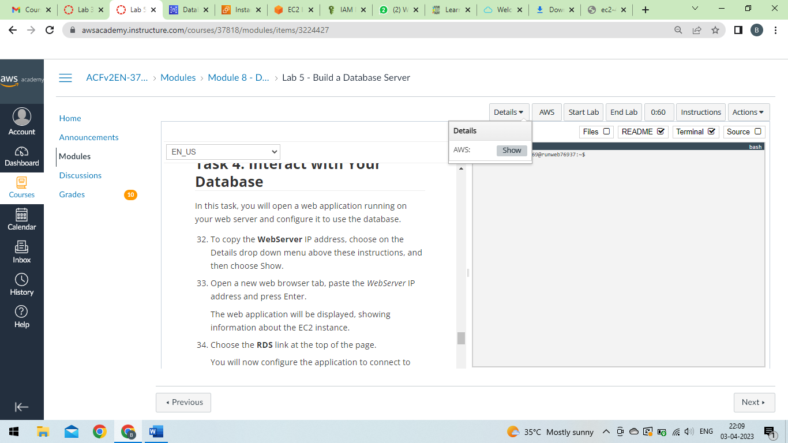

Slide 57
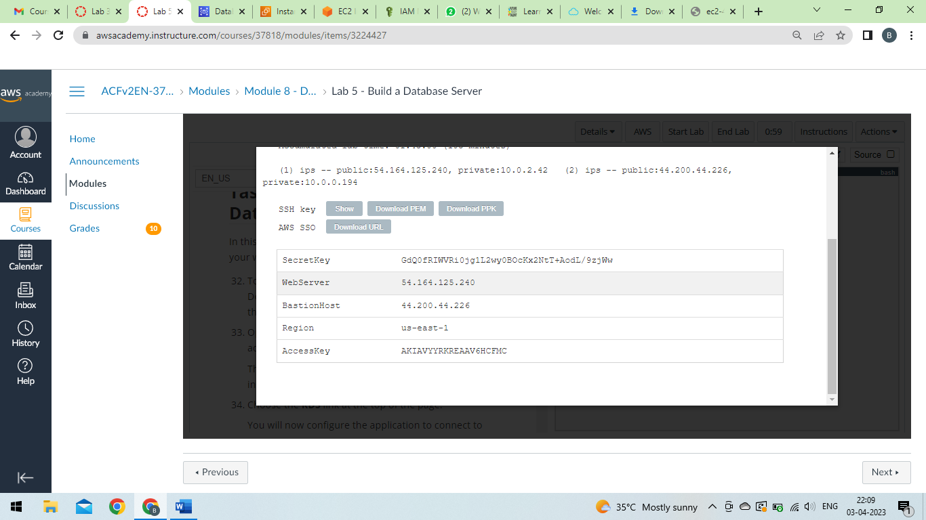

Slide 58
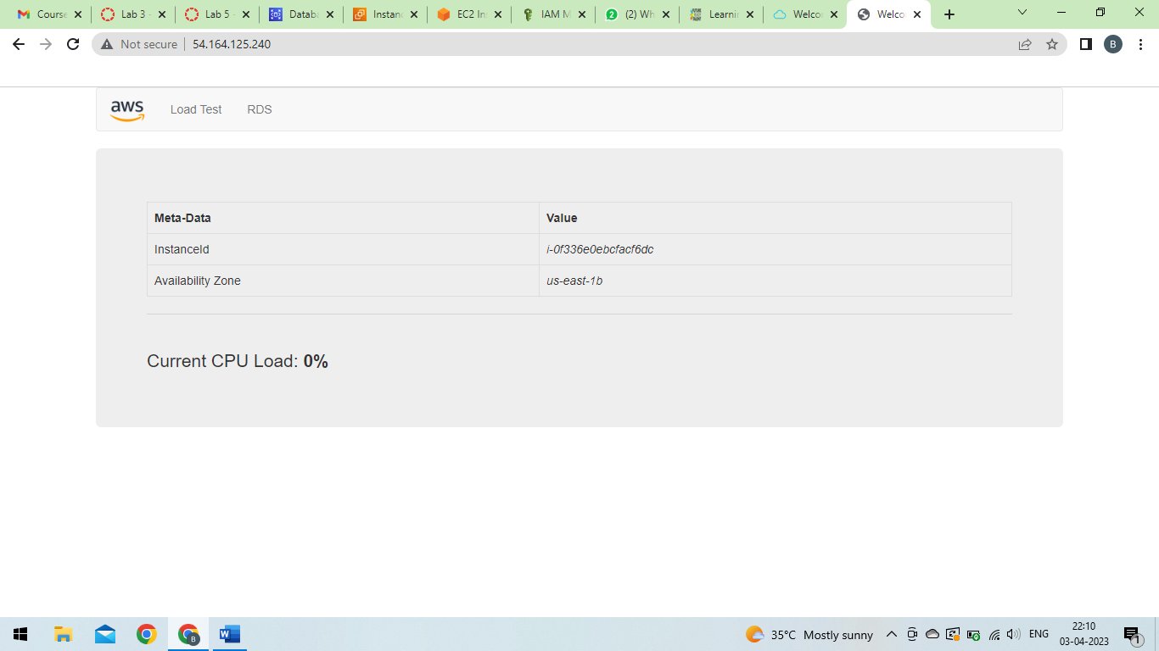

Slide 59
Load Balancer and Auto Scaling

Slide 60


Slide 61


Slide 62


Slide 63


Slide 64


Slide 65


Slide 66


Slide 67


Slide 68


Slide 69


Slide 70


Slide 71


Slide 72


Slide 73


Slide 74


Slide 75


Slide 76


Slide 77


Slide 78


Slide 79


Slide 80


Slide 81


Slide 82


Slide 83


Slide 84


Slide 85


Slide 86


Slide 87


Slide 88


Slide 89


Slide 90


Slide 91


Slide 92


Slide 93


Slide 94


Slide 95


Slide 96


Slide 97


Slide 98


Slide 99


Slide 100
IAM

Slide 101
Step1:In the AWS Management Console, on the Services menu, select IAM.
Step2:In the navigation pane on the left, choose Users.
Step3:Create the user with the following name.
Step4:Click Next and click Create user
Step 5:Choose the Groups tab.
Step 6:Choose the Security credentials tab.
Step 7:In the navigation pane on the left, choose User groups.
Choose the EC2-ReadOnlyAccess group
This will bring you to the summary page for the EC2-Support group.
Step 8:Choose the Permissions tab.
Step 9:In the left navigation pane, choose User groups.
Step 10:Choose the EC2-ReadOnlyAccess group.
Step 11:Choose the Users tab.
Step 12:In the Users tab, choose Add users.

Slide 102


Slide 103


Slide 104


Slide 105


Slide 106


Slide 107


Slide 108


Slide 109


Slide 110


Slide 111


Slide 112


Slide 113


Slide 114


Slide 115


Slide 116


Slide 117


Slide 118
EBC

Slide 120


Slide 121


Slide 122


Slide 123


Slide 124


Slide 125


Slide 126


Slide 127


Slide 128


Slide 129


Slide 130


Slide 131


Slide 132


Slide 133


Slide 134


Slide 135


Slide 136


Slide 137


Slide 138


Slide 139


Slide 140


Slide 141


Slide 142


Slide 143


Slide 144


Slide 145


Slide 146


Slide 147


